Slide 1
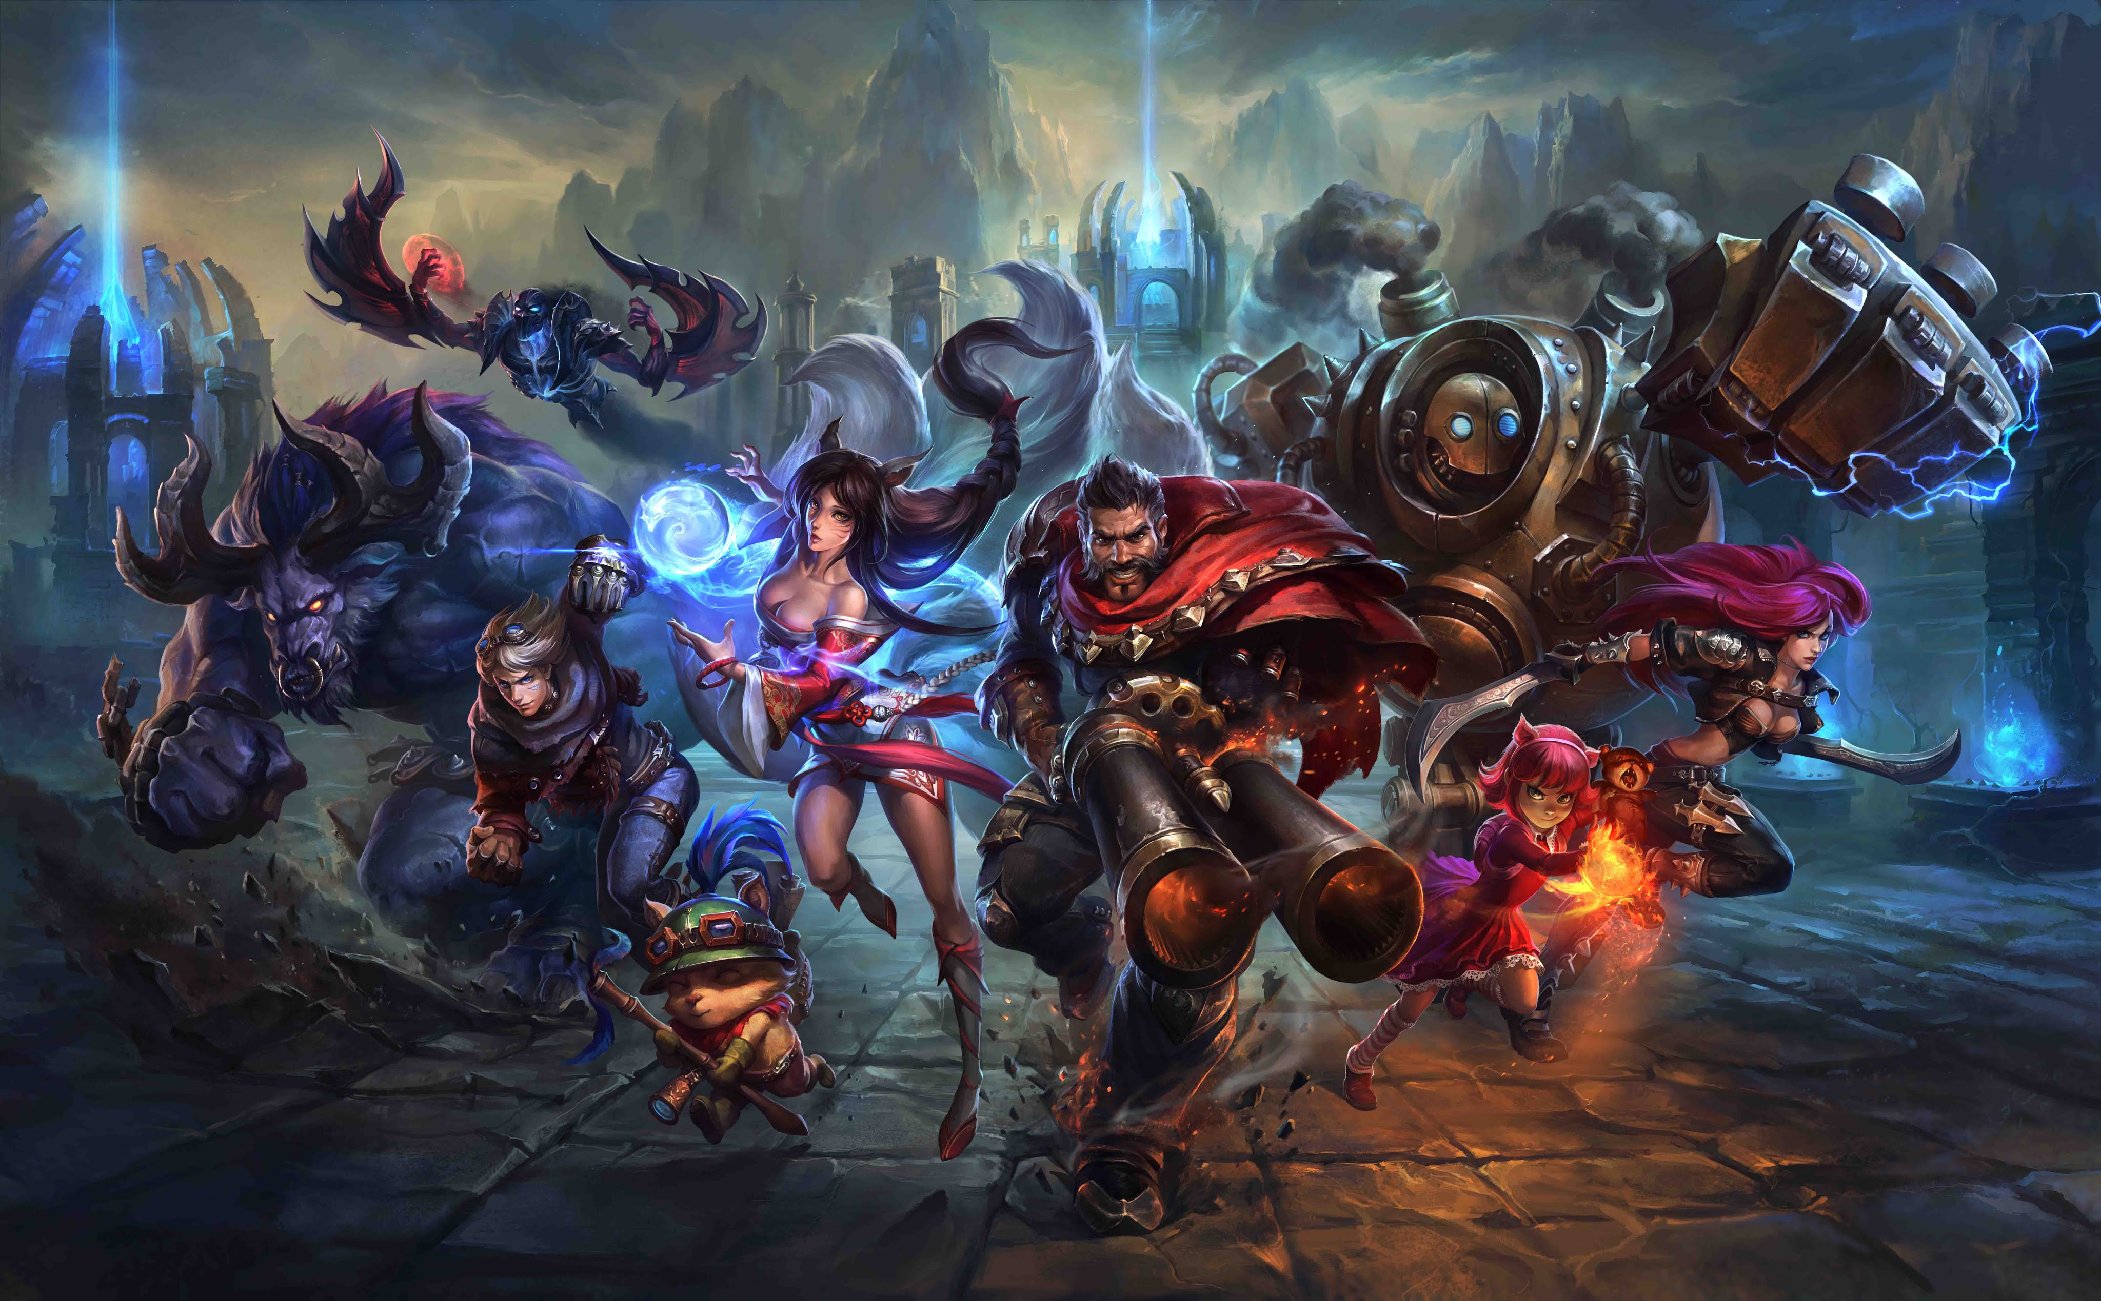
League of Legends AI
By: MattHew FreNCH, EriC JOHNSON, Nawavi Naleem

Slide 2

Motivation for the project?
To get a good grade
League of Legends is a free, multiplayer, online strategy game in which two teams fight each other to destroy the opponent’s base. The faster and more accurate decision making of a player determine who shall win.
Our job was to create a fast AI which could possibly play League of Legends faster and much more accurate than the skilled human player.

Slide 3

AI can be much more accurate with detection throughout the game as opposed to a human player
A computer can react, compute decisions, and eliminate scenarios much quicker

Slide 4
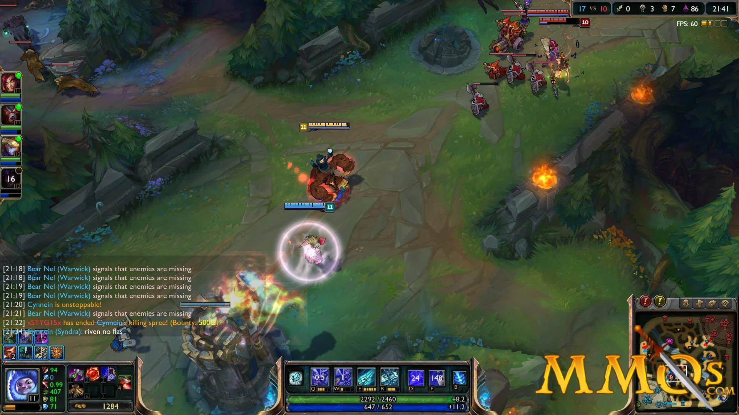
Motivation for the project..(CONT.)
Ai is developed by matt
Before parallelism, the ai played at a beginner level
In this project, we focused on improving the speed of detection and decision-making by using parallelism

Slide 5

THE LOGIC BEHIND THE SCENCES: DETECTION MANAGER
Detection Manager is the visual cortex of AI.
Detection Manger is the key component to analysis
OPENMP used for the parallelization of the code

Slide 6
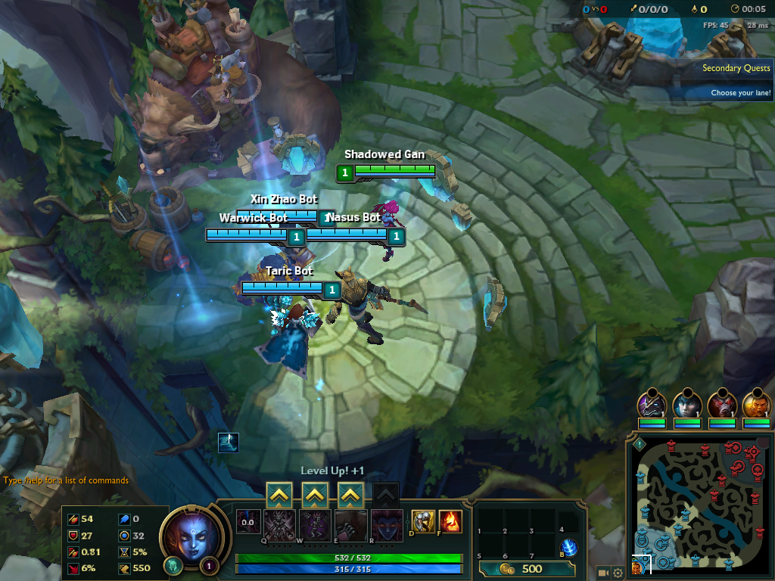
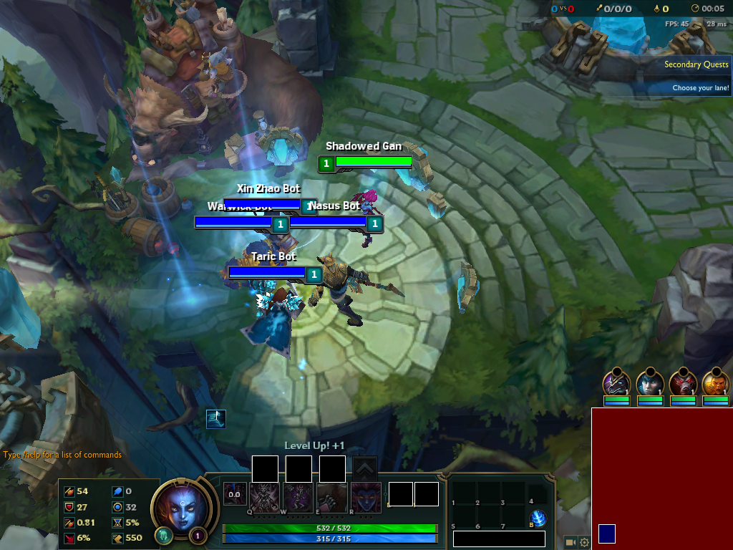


Slide 7
Benchmark Results & Overview
Specifications
Beginning
Half a seconds to do a full screen scan
2011 Apple MaC book pro
Intel core I-5 Processor
Gcc compiler
After parallelism
New code with openMP took 0.08 seconds
6 times speed up

Slide 9
LIVE DEMO

Slide 10

IN CONCLUSION…
…WILL CRUSH THE HUMAN PLAYER!!!

